Slide 1
AzureKinect
Smoothing of Depth Image

Slide 2
TRANSITION/GIT/CHALLENGES

Slide 3
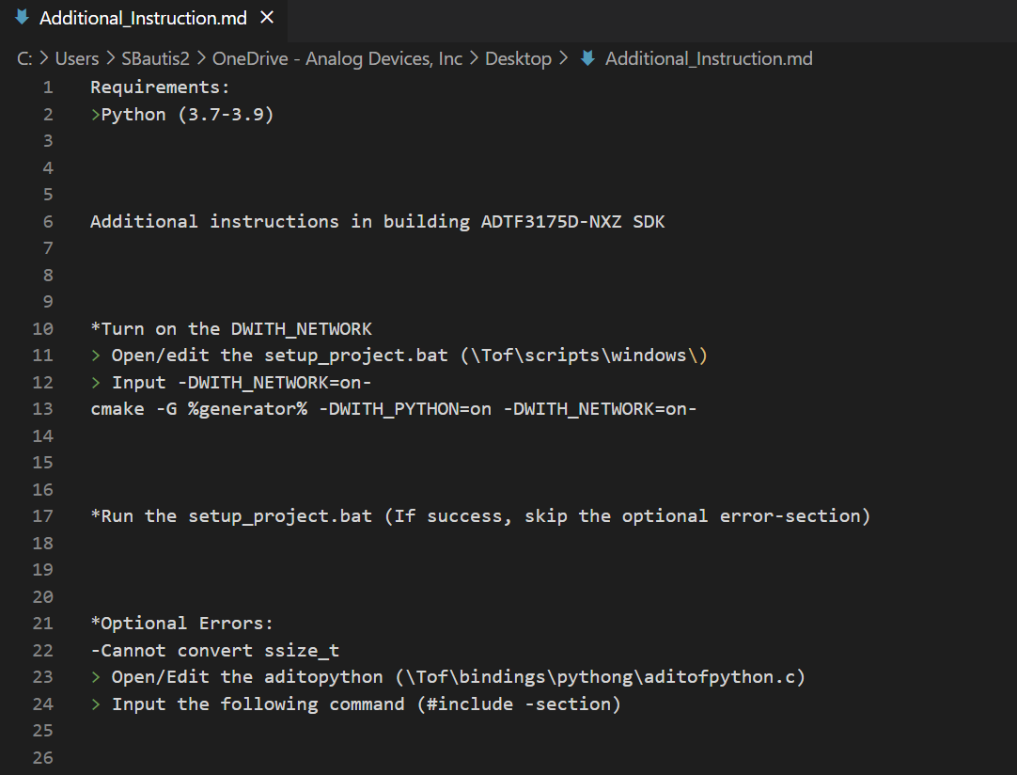
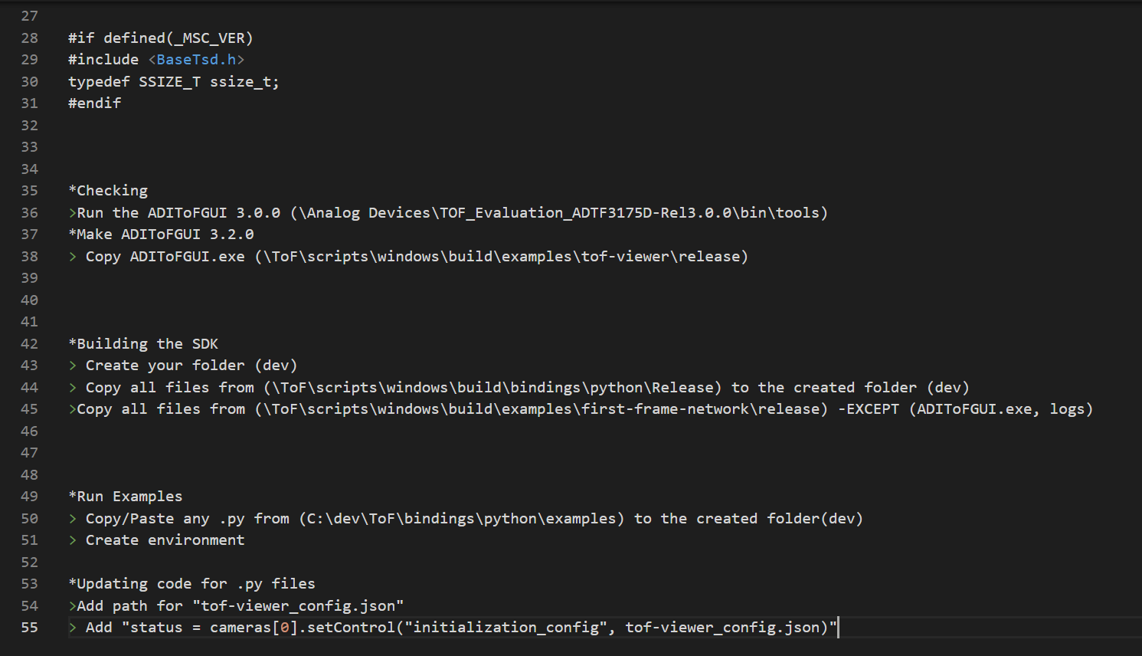
Additional Instruction for Building ADTF3175D-NXZ

Slide 4
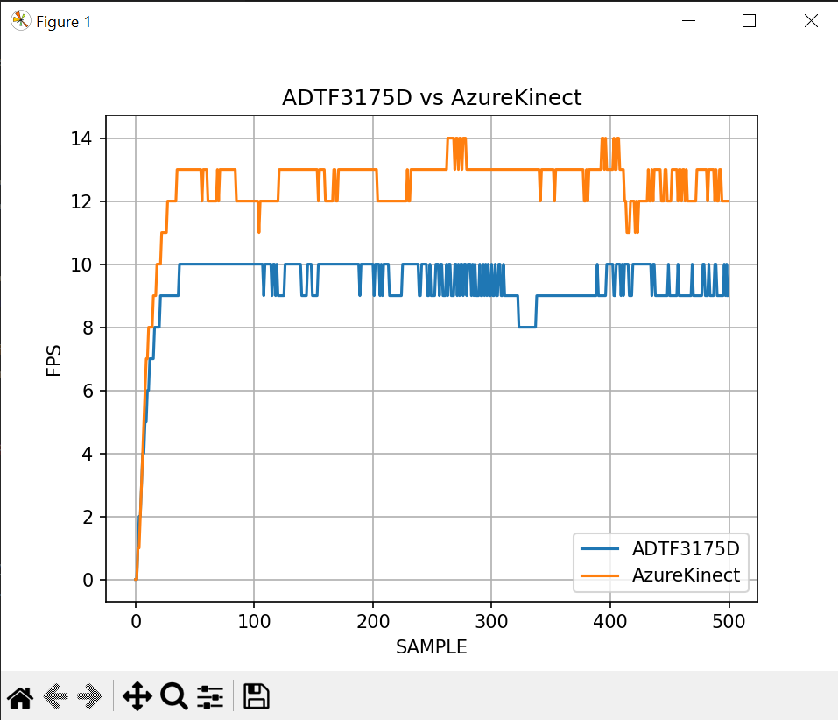
Evaluating ADTF3175D-NXZ
Bakit ?

